Slide 1


Slide 2
About today…
Forms
Creating form
Handling form
Connecting form with php

Slide 3
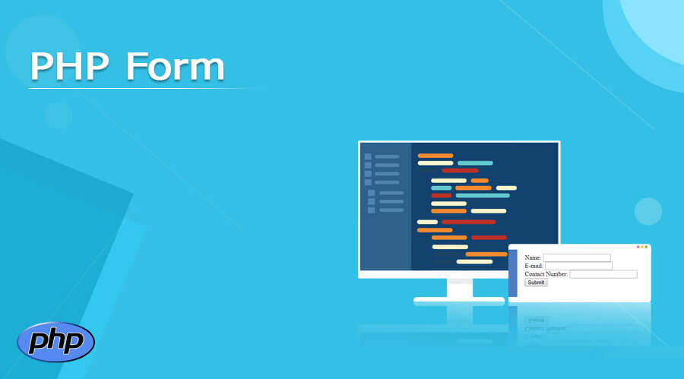

Slide 4
Basics of HTML Forms
Forms Overview
HTML forms act as a bridge between users and web servers
Allows interaction and data exchange
Form Elements
Form elements like input fields, text areas, select dropdowns, and buttons will be discussed soon
Form Attributes
Dive into form attributes such as action (where data is sent) and method (GET or POST for data transmission)

Slide 5
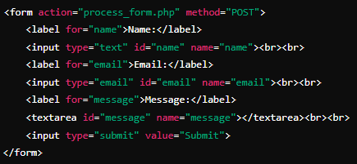
Creating simple HTML Form
Elements
HTML code for a basic form
Input fields for name, email, message
Submit button

Slide 6
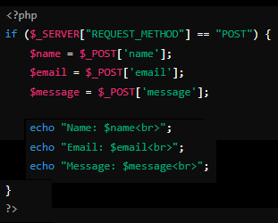
Handling Form in PHP
Superglobals
$_POST and $_GET arrays to access form data

Slide 7


Slide 8

What is the HTTP method commonly used for submitting form data?
Which superglobal array in PHP is used to retrieve form data sent with the POST method?
Which PHP function is used to check if a form field is empty or not?

Slide 9

Task 1
Create a simple HTML form with fields for name, email, and a submit button. Use the POST method to send the form data to a PHP script for processing.
Task 2
Implement form validation for the file upload field to check for allowed file types, maximum file size, etc. Display appropriate error messages if validation fails.

